Slide 1

eService Architecture
By Luke Yang

Slide 2
Agenda
eService Overall Architecture(approx. 10 min.)
Architecture of SanjelCommonObjectsService (approx. 40 min.)
Architecture of SanjeleServiceWeb (approx. 10 min.)
Architecture of SanjeleSanjelClient (approx. 20 min.)
Q&A

Slide 3
eService Overall Architecture
eService subsystems&components
eService deployment

Slide 4
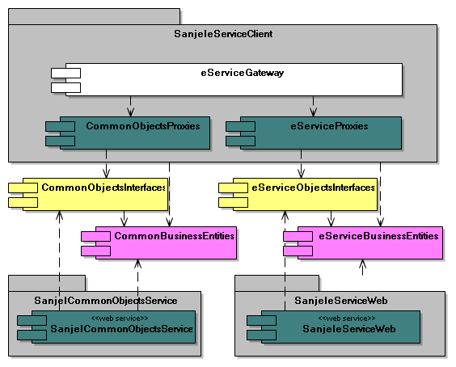
eService Subsystems&Components
Integration
Proxies
Contracts
Schemas
Services

Slide 5
eService Subsystems&Components
SanjelCommonObjectsService
  Schema: CommonBusinessEntities
  Contract: CommonObjectsInterfaces
  Service: SanjelCommonObjectsService
SanjeleServiceWeb
  Schema: eServiceBusinessEntites
  Contract: eServiceObjectsInterfaces
  Service: SanjeleServiceWeb
SanjeleServiceClient
  Service Proxies:
    CommonObjectsProxies -> SanjelCommonObjectsService
    eServiceProxies -> SanjeleServiceWeb
  Gateway: eServiceGateways

Slide 6
eService Deployment
Overview
Client deployment
Web Server deployment

Slide 7
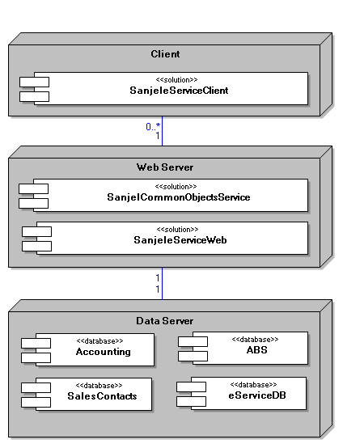
eService Deployment Overview
Clients
  SanjeleServiceClient
Web Server
  SanjeleServiceWeb
  SanjelCommonObjects
Data Server
  ABS
  Accounting
  eServiceDB
  SalesContacts

Slide 8
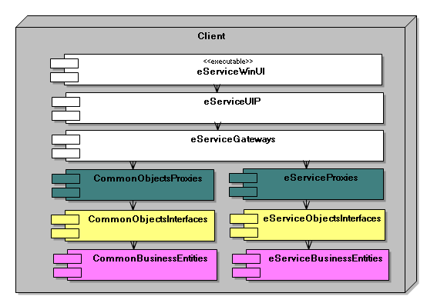
eService Client Deployment

Slide 9
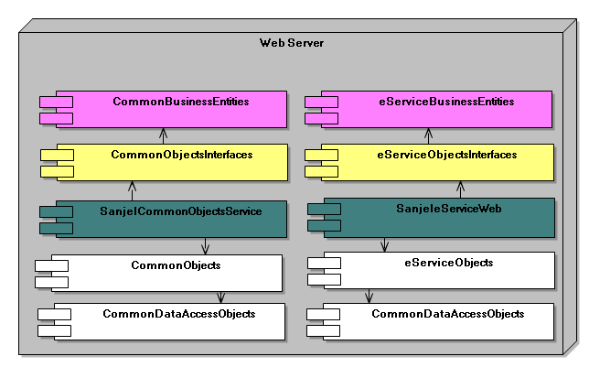
eService Web Server Deployment

Slide 10
Architecture of SanjelCommonObjectsService
Components Overview
Deployments Overview
Essential Packages and Classes
  Business Entities Classes
  Data Access Objects Classes
  Business Objects Classes
  Service Interfaces Classes
  Service Proxies Classes

Slide 11
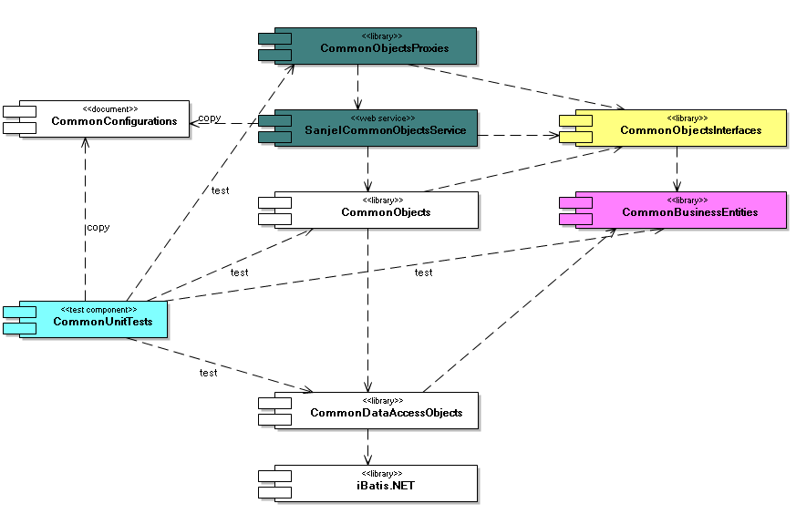
Architecture of SanjelCommonObjectsService
Components Overview

Slide 12
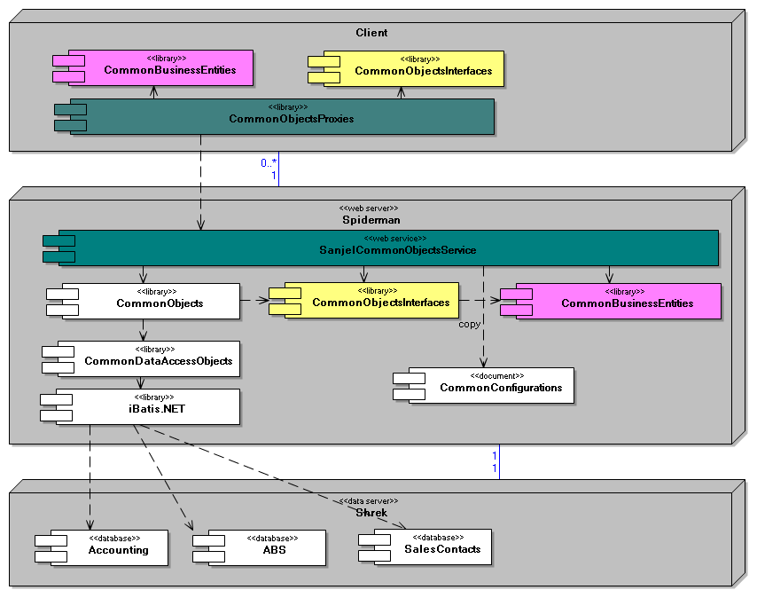
Architecture of SanjelCommonObjectsService
Deployments Overview

Slide 13
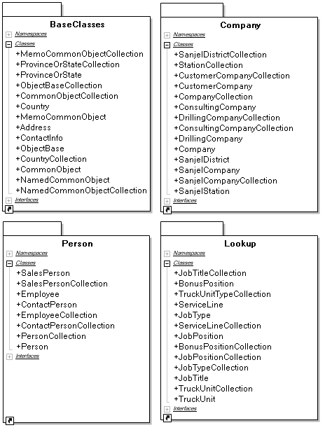
Architecture of SanjelCommonObjectsService
Business Entities

Slide 14
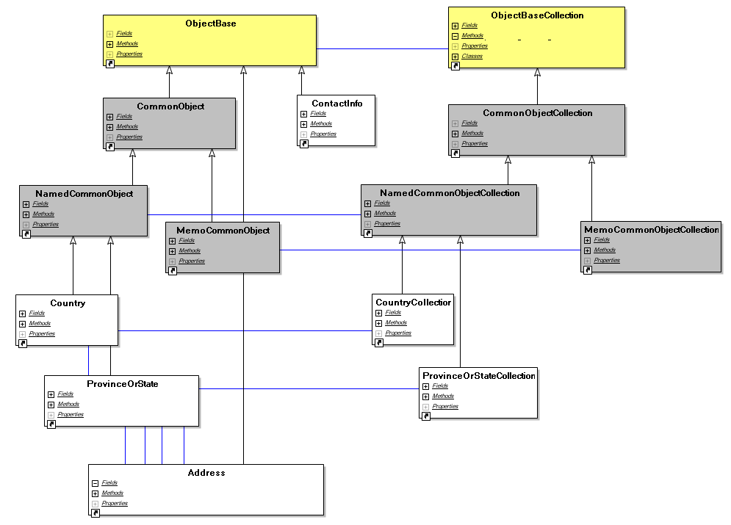
Architecture of SanjelCommonObjectsService
BaseClasses Package Overview

Slide 15
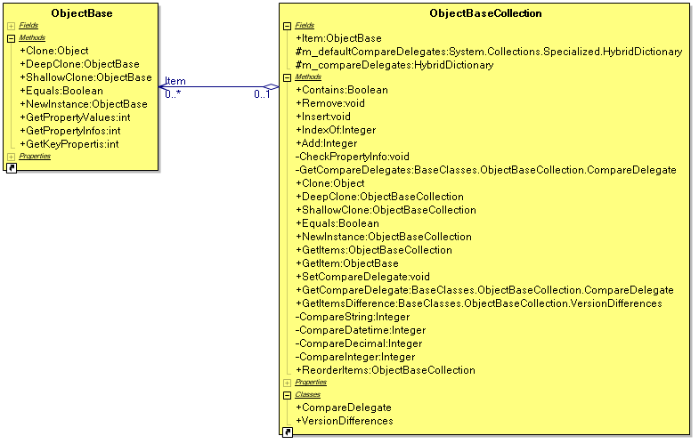
Architecture of SanjelCommonObjectsService
ObjectBase and ObjectBaseCollection

Slide 16
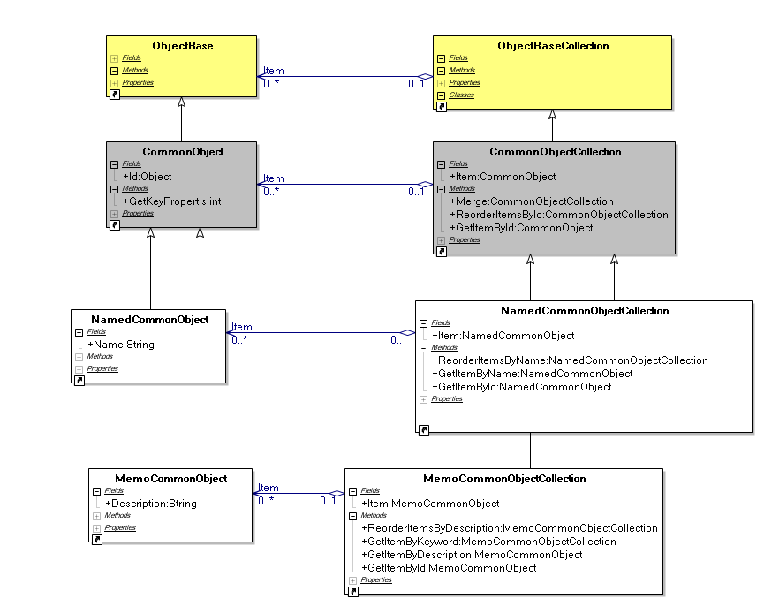
Architecture of SanjelCommonObjectsService
ObjectBase and ObjectBaseCollection Hierarchy

Slide 17
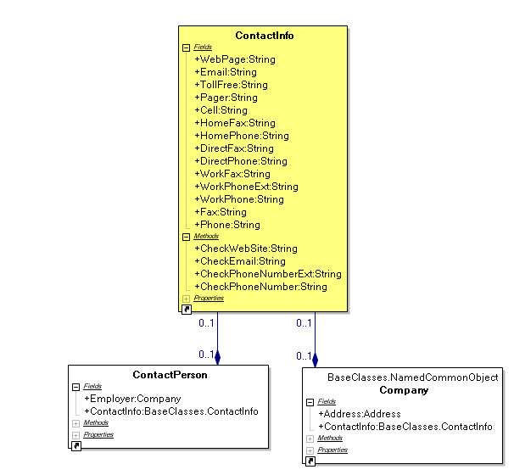
Architecture of SanjelCommonObjectsService
ContactInfo

Slide 18
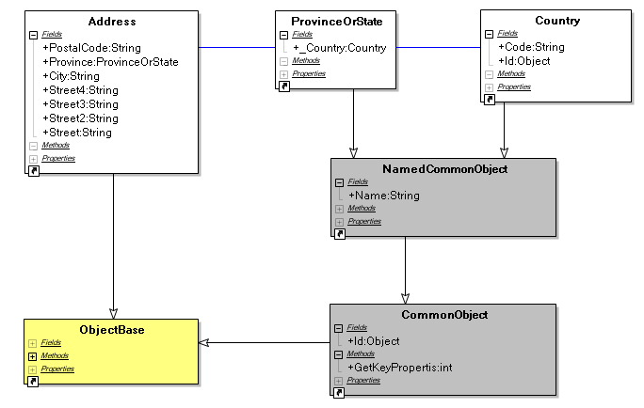
Architecture of SanjelCommonObjectsService
Address

Slide 19
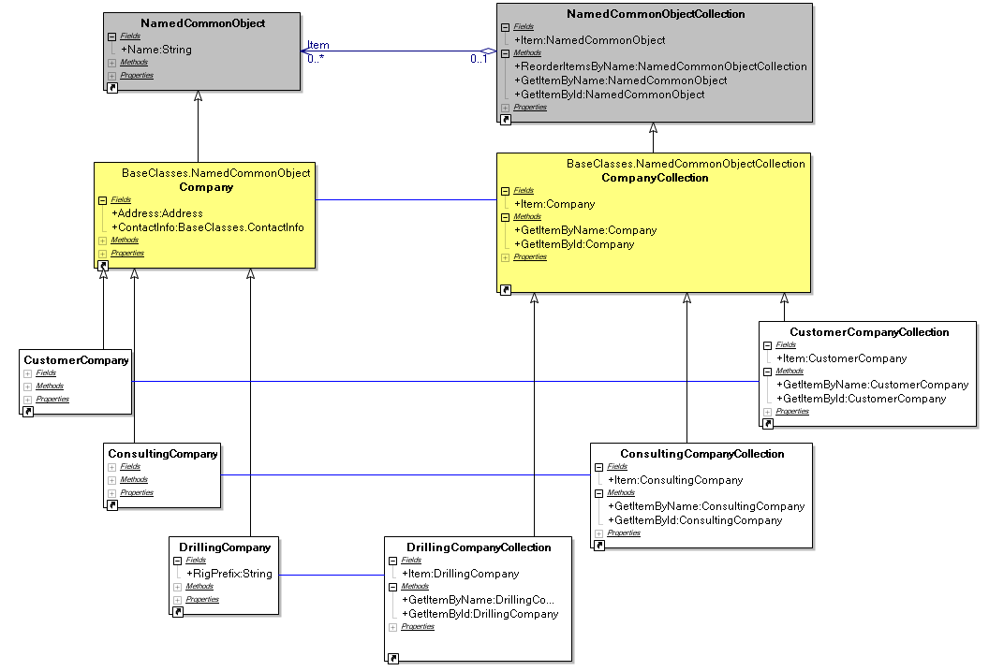
Architecture of SanjelCommonObjectsService
Company Package Overview

Slide 20
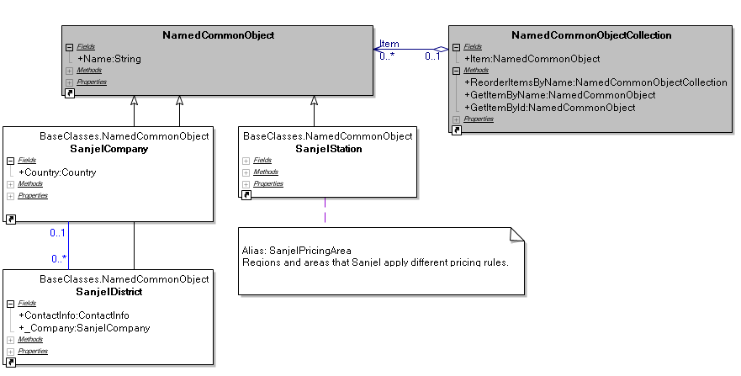
Architecture of SanjelCommonObjectsService
Company Package - Sanjel Organizational Units

Slide 21
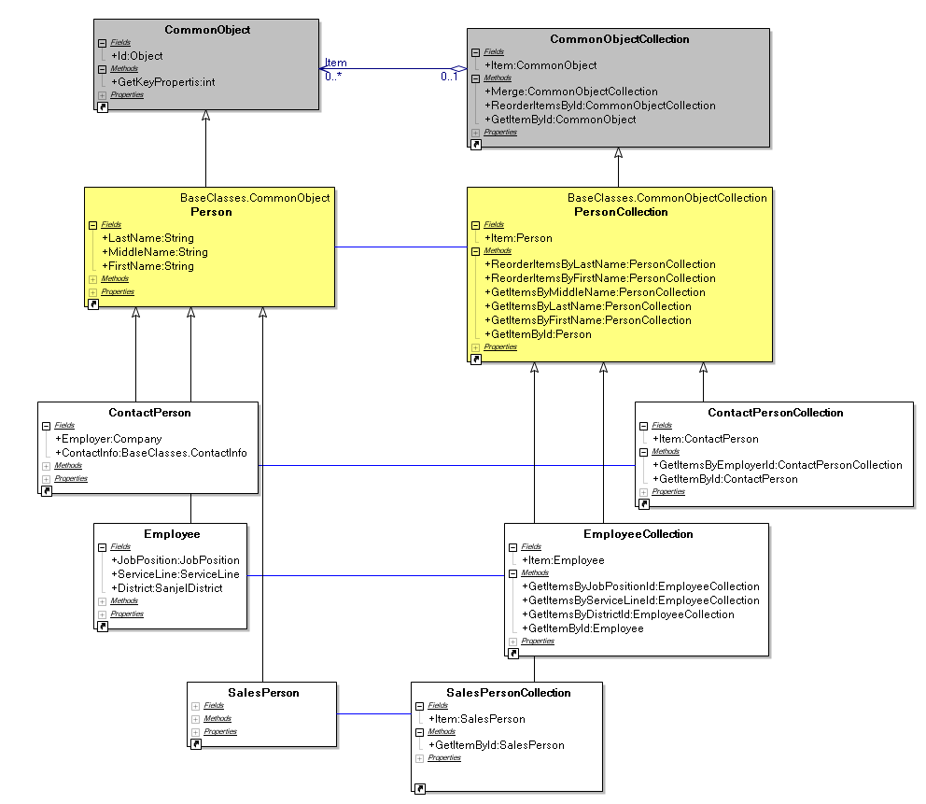
Architecture of SanjelCommonObjectsService
Person Package Overview

Slide 22
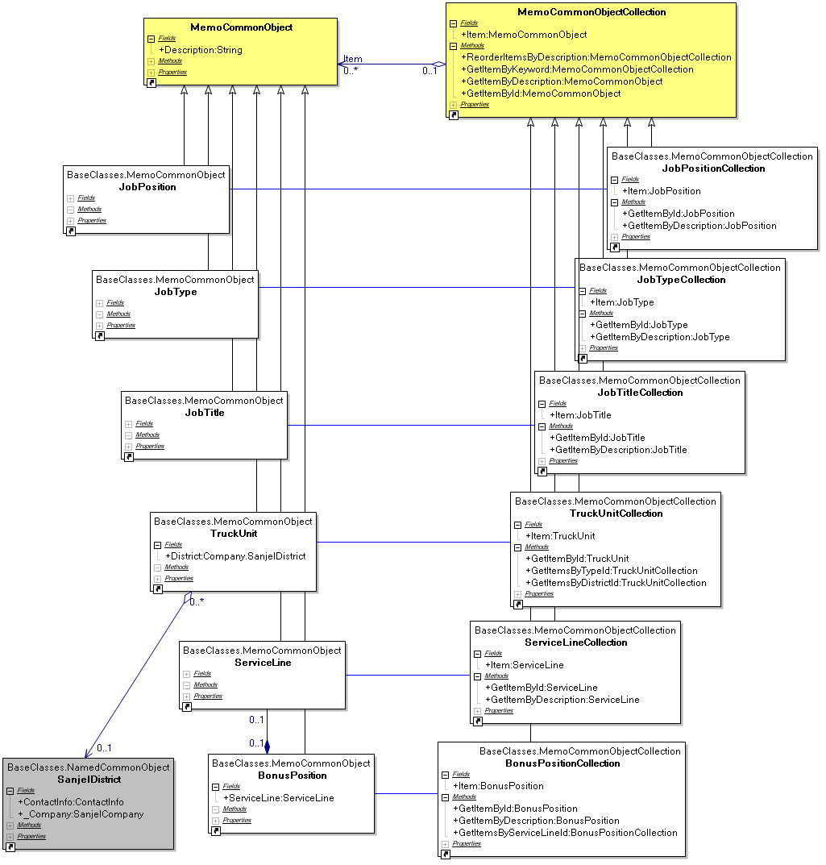
Architecture of SanjelCommonObjectsService
Lookup Package Overview

Slide 23
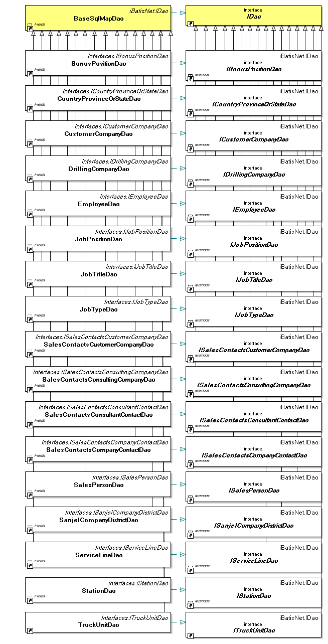
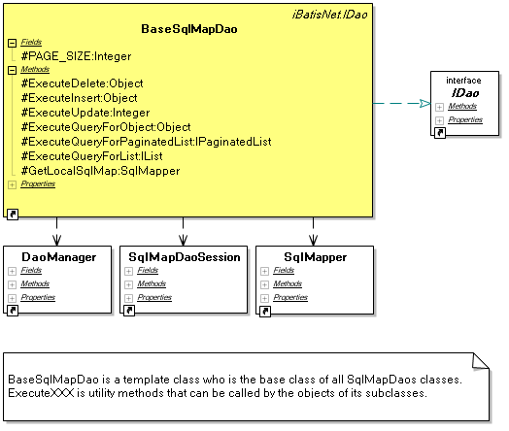
Architecture of SanjelCommonObjectsService
Data Access Objects

Slide 24
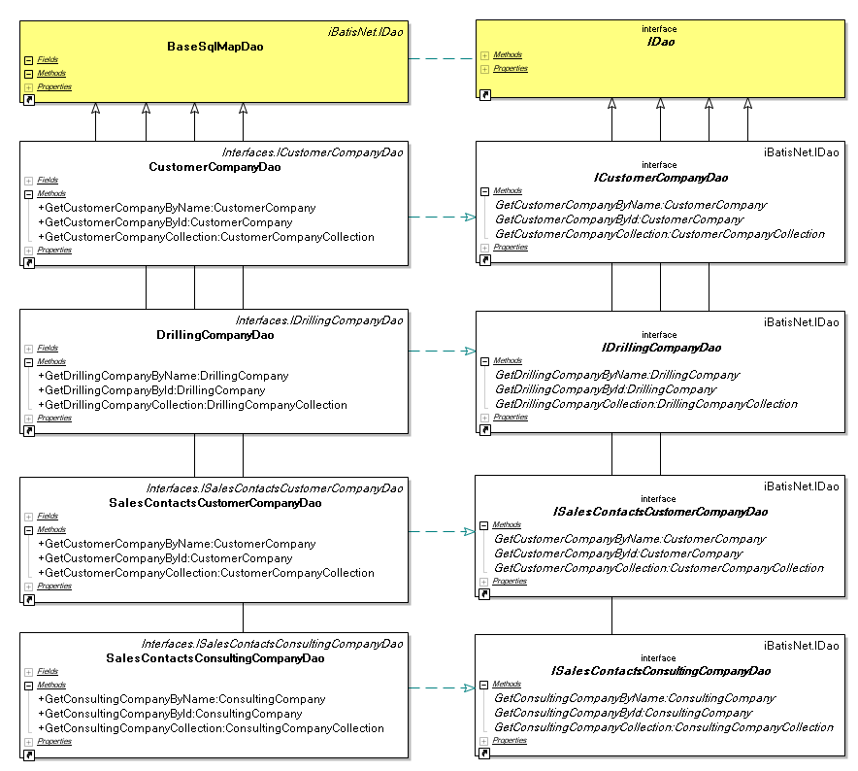
Architecture of SanjelCommonObjectsService
DAOs – Company Daos

Slide 25
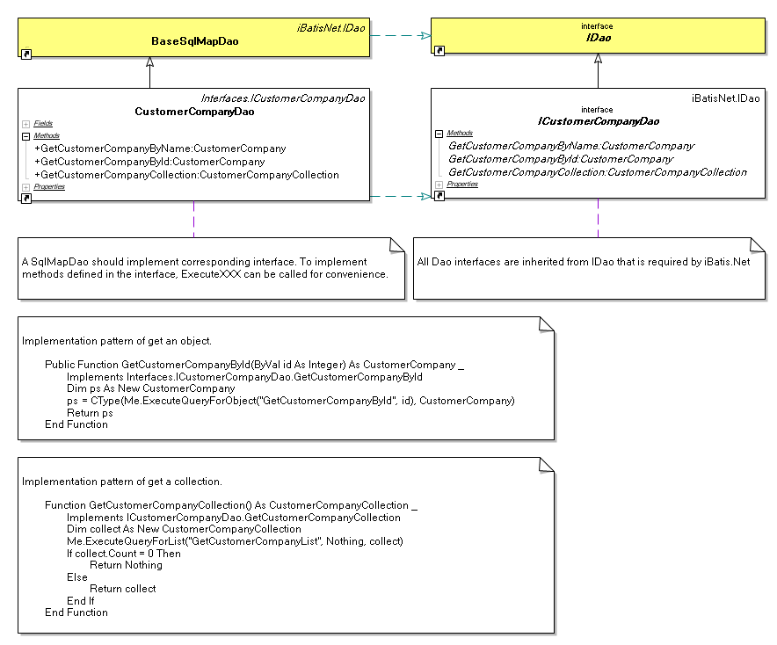
Architecture of SanjelCommonObjectsService
DAOs - Implementation Guide (CustomerCompanyDao)

Slide 26
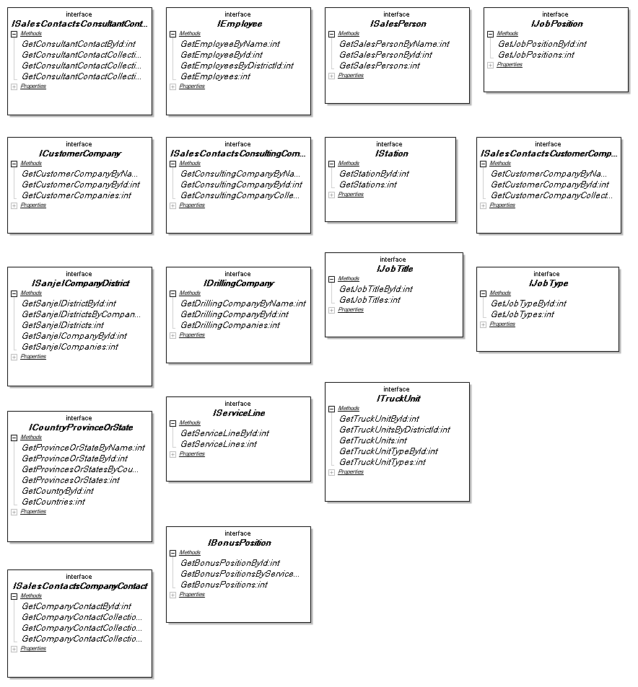
Architecture of SanjelCommonObjectsService
Business Layer - Interfaces

Slide 27
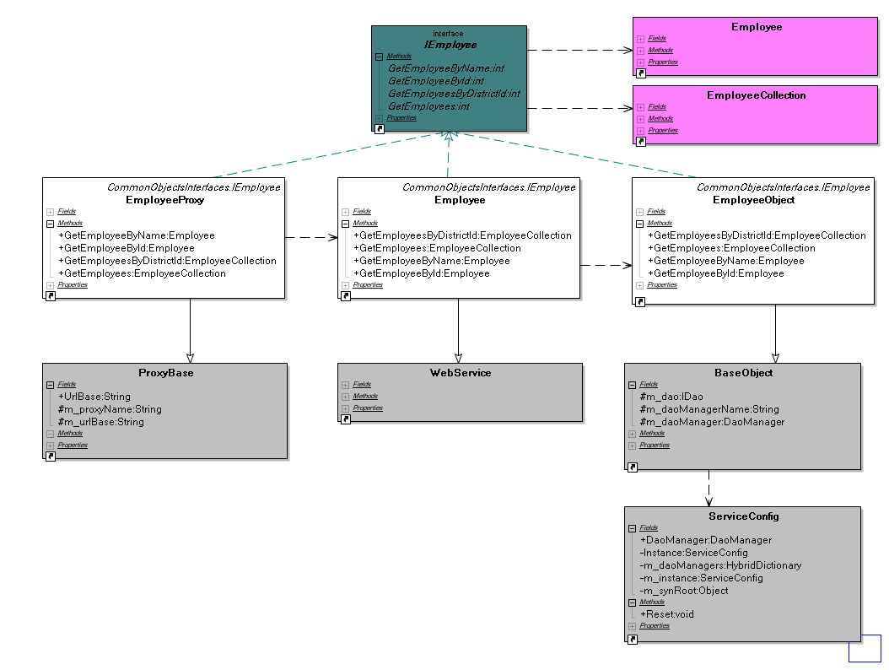
Architecture of SanjelCommonObjectsService
Business Layer – Employee Hierarchy
Explicit Boundary

Slide 28
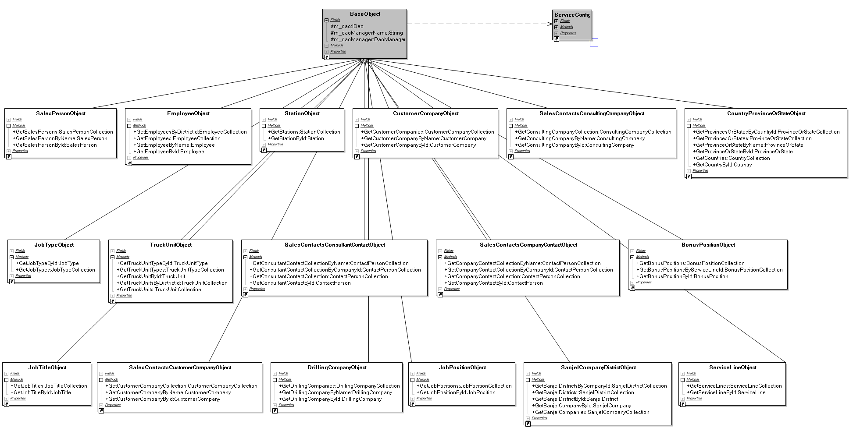
Architecture of SanjelCommonObjectsService
Business Layer – Business Objects

Slide 29
Architecture of SanjeleServiceWeb
Components Overview
Deployments Overview

Slide 30
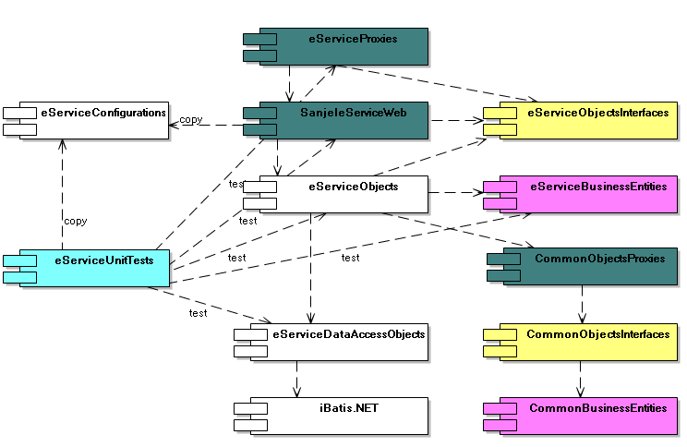
Architecture of SanjeleServiceWeb
Components Overview

Slide 31
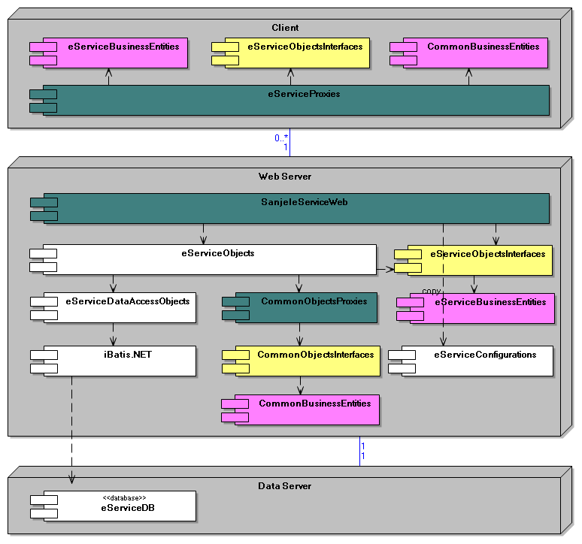
Architecture of SanjeleServiceWeb
Deployments Overview

Slide 32
Architecture of SanjeleSanjelClient
Components Overview
Deployments Overview
Essential Packages and Classes

Slide 33
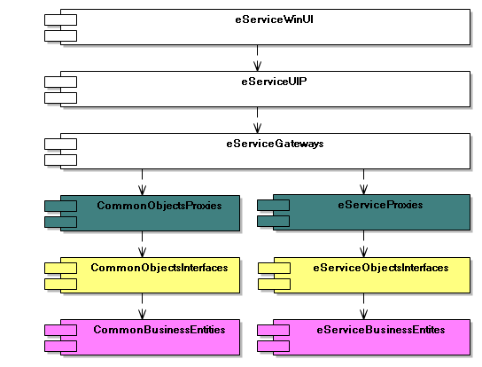
Architecture of SanjeleSanjelClient
Components Overview

Slide 34
Architecture of SanjeleSanjelClient
Deployments Overview

Slide 35
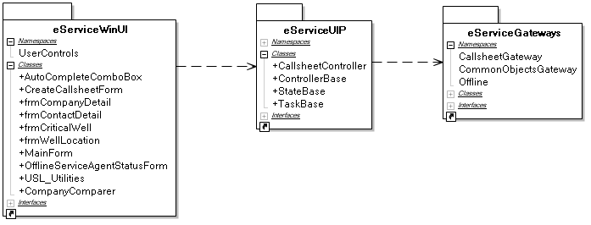
Architecture of SanjeleSanjelClient
Packages Overview

Slide 36
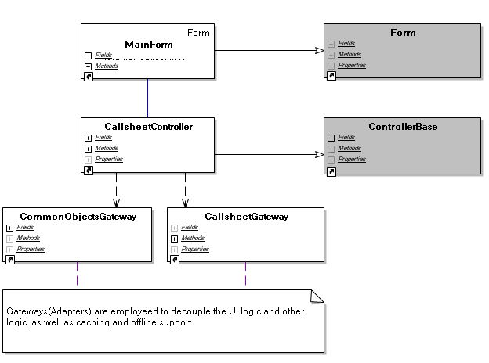
Architecture of SanjeleSanjelClient
Form Controller Gateway

Slide 37
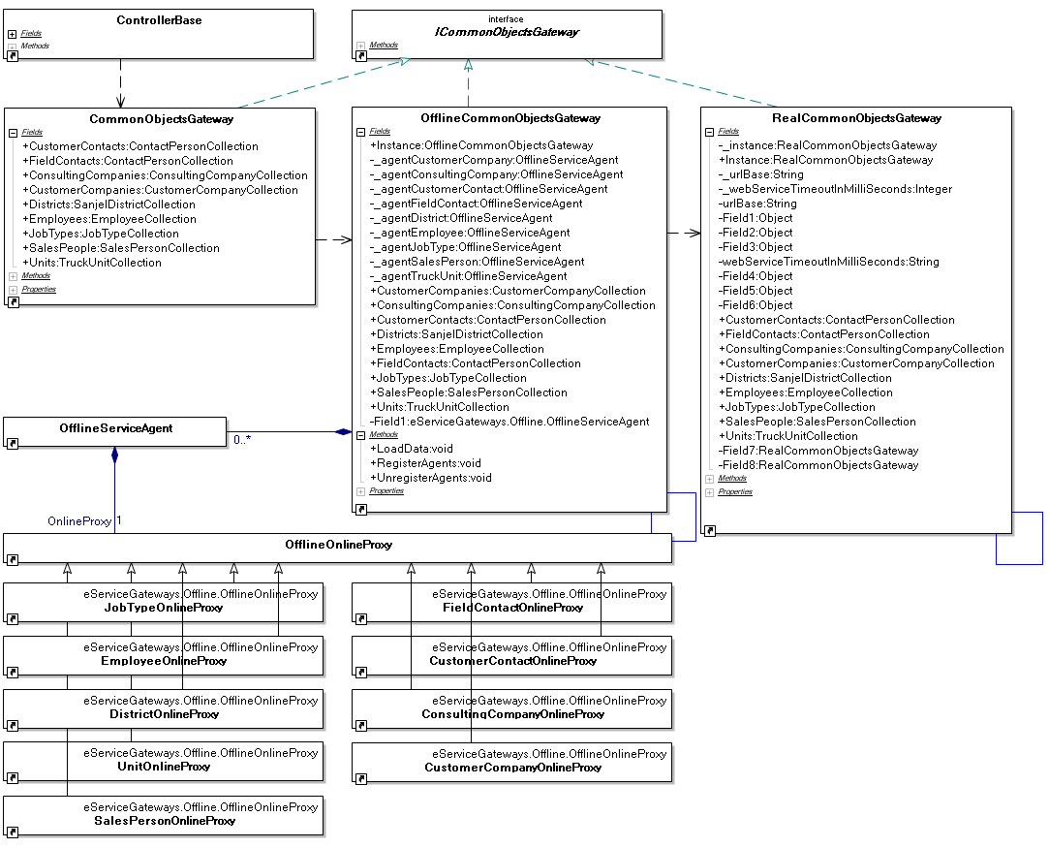
Architecture of SanjeleSanjelClient
CommonObjectsGateway

Slide 38
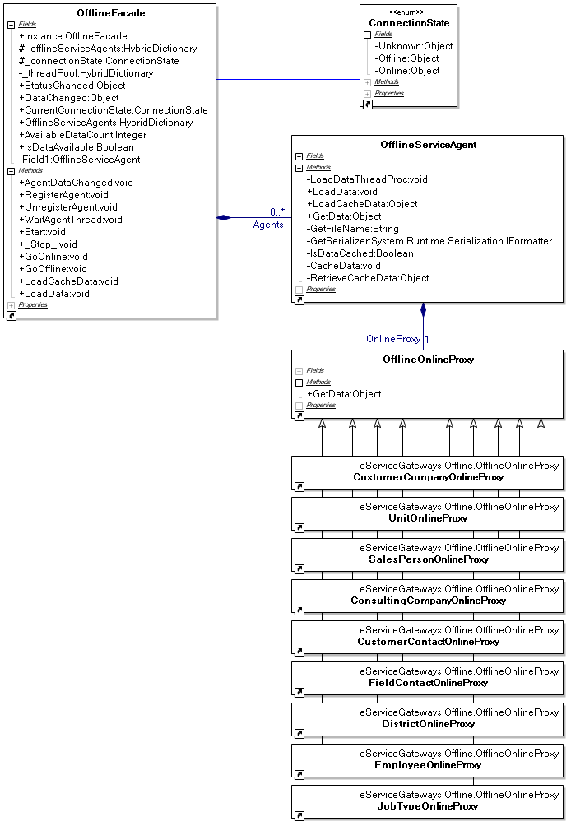
Architecture of SanjeleSanjelClient
Offline Support

